Slide 1
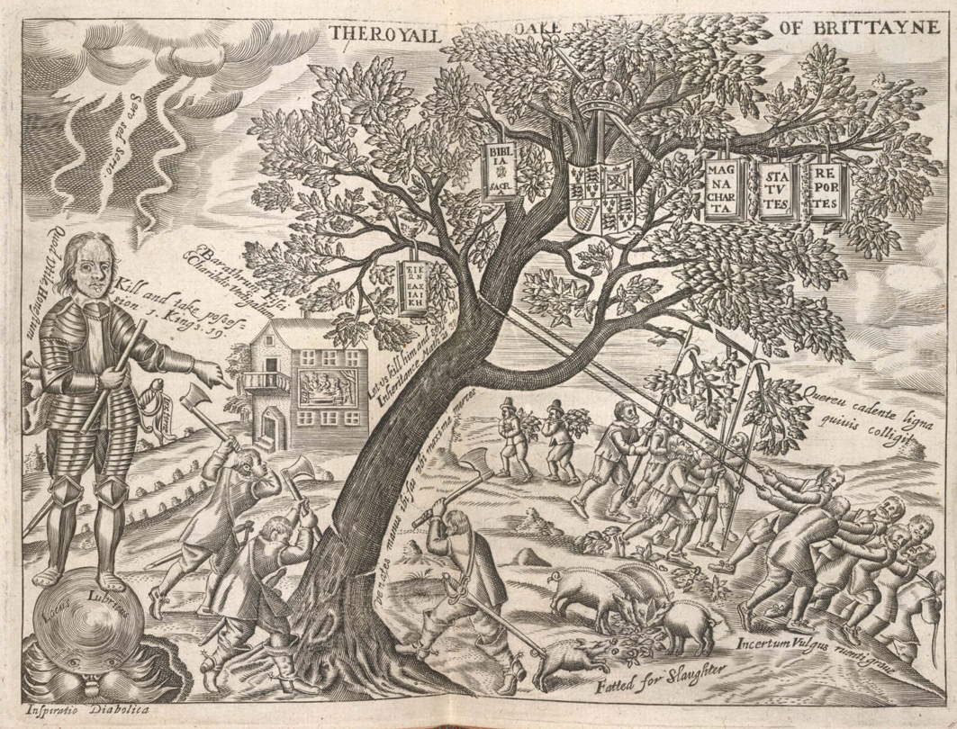
Cromwell: Myth and Reality John Morrill. Huntingdon. 5 Dec 2018

Slide 2
Cromwell the Iconoclast
Mr. Hich, least the Souldiers should in any tumultuarie, or disorderly way attempt the Reformation of your Cathedrall church, I requier you to forbeare altogether your Quire service soe unedifyinge, and offensive, and this as you will answere it, if a{ny}[?contention] \disorder/ should arise thereupon.Your lovinge friend Oliver Cromwell Jan. 10th 1643 [=1644]

Slide 3
...no person or persons...professing to believe in Jesus Christ, shall from henceforth be anyways troubled, Molested or discountenanced for or in respect of his or her religion nor in the free exercise thereof within this Province... (Maryland Toleration Act, 1649, supported by the Lord Proprietor the Catholic Lord Baltimore, deposed 1654, reinstated 1656).

Slide 4
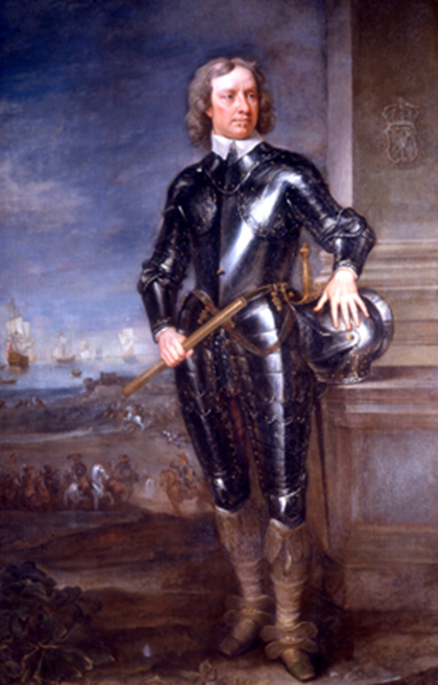
Anti-Catholic?
A portrait of
Cromwell probably
visualised as at the
siege of Drogheda,
Sept 1649.

Slide 5
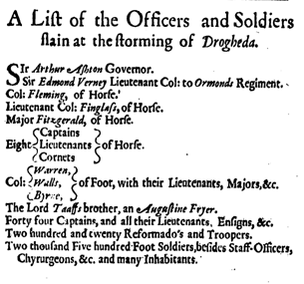
Evidence that civilians were killed at Drogheda

Slide 6
Anti-Catholic?
The original Irish printing of Cromwell’s promise to ‘extirpate’ popery if not papists throughout Ireland

Slide 7
CROMWELL TO VALENTINE WALTON ABOUT THE DEATH OF HIS SON AT MARSTON MOOR
Sir you know my tryalls this way, but the Lord supported mee, with this that the Lord tooke him into the happinesse wee all pant after, and live for. There is your precious child, full of Glory, to know Sinn nor Sorrow any more. Hee was a gallant younge man, exceedinge gracious god give you his comfort, before his death Hee was soe full of comfort, that to Franke Russell and my selfe Hee could not expresse itt, itt was soe great above his paine \this hee said to us/ , indeed itt was admirable, a little afterHee sayd one thinge lay upon his Spirit, I asked him what that was was, Hee told mee, that it was, that God had not Suffered him to bee \noe more/ the executioner of his enemies… Hee was a precious younge man, fitt for God, you have
cause to blesse the Lord, Hee is a glorious Sainct in heaven. wherin you ought exceedingly to rejoyce, lett this drinke up your sorrowe, because \seinge/ theise are not fayned words to comfort you, but the thinge is soe real and undoubted a truth,you may doe all thinges by the strength of christ, seeke that, and you shall easily beare your tryall draw \lett/ this publike mercy to the church of God make you to forgett your private sorrowe, the Lord bee your strength soe prayes
your truly faythfull and loving Brother

Slide 8
Cromwell at the Putney Debates, 11 Nov 1647
Colonel Thomas Harrison ‘made a narration concerning some thinges that lay uppon his spiritt in relation to the Kinge, Lords and the Reserve. That the Kinge was a Man of Bloud, and therefore the Engagement taken off, and that they were to prosecute him.’ Cromwell
answered him by putting severall Cases in which Murther may to bee punished… Stated the Case Of David uppon Joab’s Killing of Abner, That hee spar’d him uppon two prudentiall Grounds, one, That hee would nott hazard the spilling of more blowd in regard the Sons of Zeruiah were too hard for him.

Slide 9
Cromwell rejects the Crown, 13 April 1657
Truly the prudence of God hath laid aside this Title providentially de facto, and this not by suddain humor or passion, but it hath been by issue of as great deliberation as ever was in a Nation, it hath been the issue of 10 or 12 yeares civil war. … God hath seemed so to deal with the persons, and with the family, but he blasted the title, and you know when a man comes to reflect, and see this is done, and laid in the dust, I can make no conclusion but this, they may have strong impression upon such weak men as I am, and perhaps, (if there be any such) upon weaker men it will be stronger. I will not seek to set up that which Providence hath destroyed, and laid in the dust, and I would not build Iericho again, and this is somewhat to me, and to my Iudgement and conscience, that it is true , it is that that hath an aw upon my spirit, and I must confesse as the times are, they are very fickle, very un-certain

Slide 10
King Oliver?
‘So great is Lord General Cromwell that you will make him your Doge’
‘So great is Lord General Cromwell that he is unus instar omnium et in effectu rex’
From the journal of Hermann Mylius, ambassador for the Count of Oldenburg, watching Cromwell’s return in triumph from Worcester. Sept 1651

Slide 11
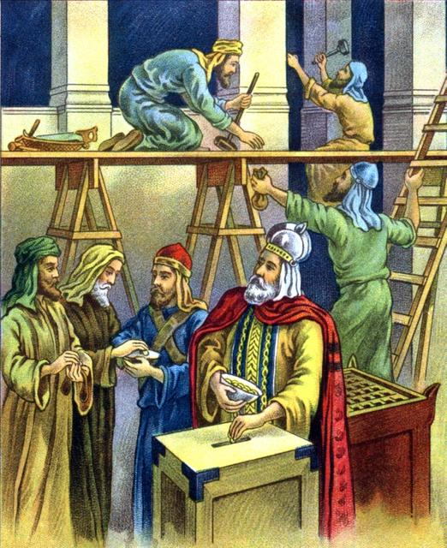
Cromwell and biblical types: Gideon, Moses Josiah

Slide 12
Modern parallels?

Slide 13
Words with which Cromwell could identify
²A time to be born, and a time to die; a time to plant, and a time to pluck up that which is planted; ³A time to kill, and a time to heal; a time to break down, and a time to build up; ⁴A time to weep, and a time to laugh; a time to mourn, and a time to dance; ⁵A time to cast away stones, and a time to gather stones together; a time to embrace, and a time to refrain from embracing; ⁶A time to get, and a time to lose; a time to keep, and a time to cast away; ⁷A time to rend, and a time to sew; a time to keep silence, and a time to speak; ⁸A time to love, and a time to hate; a time of war, and a time of peace. Ecclesiastes 35

